Slide 1
CS186: Introduction to Database Systems
Joe Hellerstein
Spring 2012

Slide 2
Queries for Today
Why?
What?
Who?
How?
For instance?

Slide 3
Queries for Today
Why?
What?
Who?
How?
For instance?

Slide 4
Why?
Data is at the center of many things.

Slide 5
Why?
Data is at the center of many things.
everything

Slide 6



Slide 7
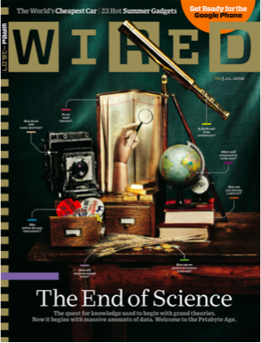

Slide 8
The quest for knowledge used to begin with grand theories.
Now it begins with massive amounts of data.
Welcome to the Petabyte Age.

Slide 9
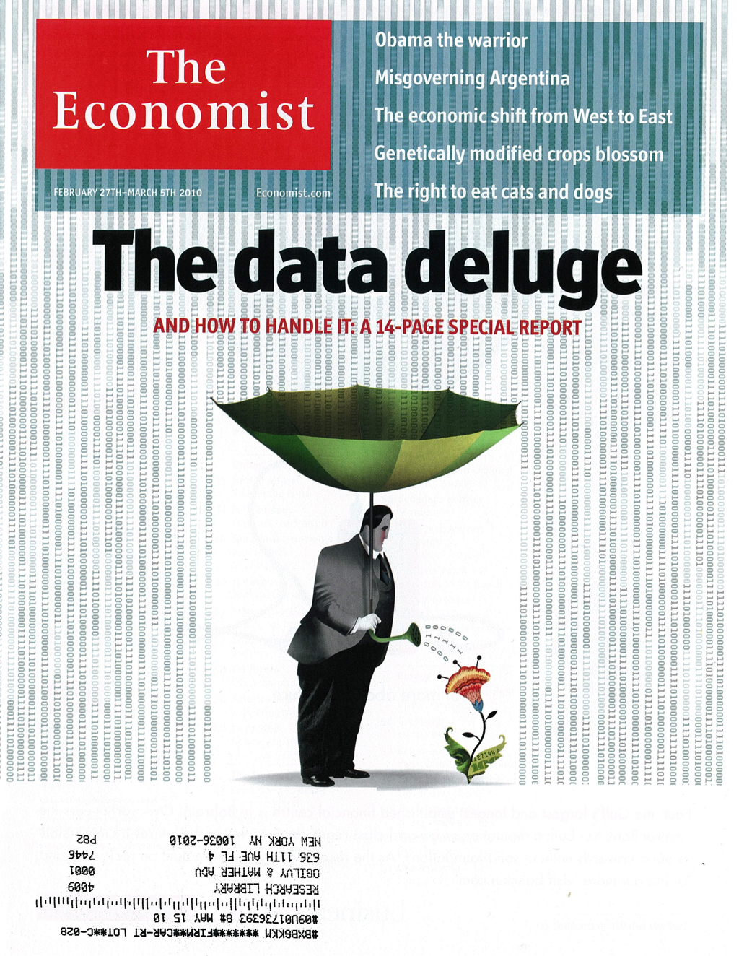

Slide 10
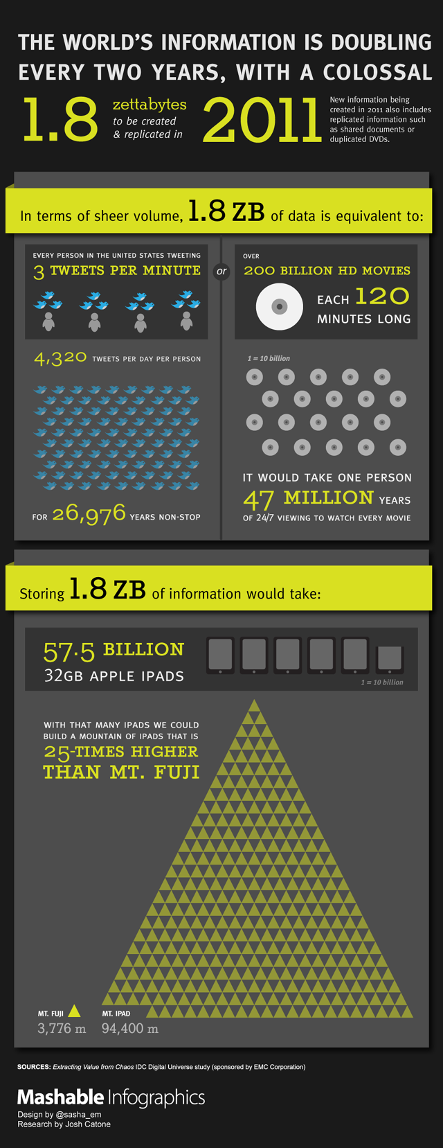

Slide 13
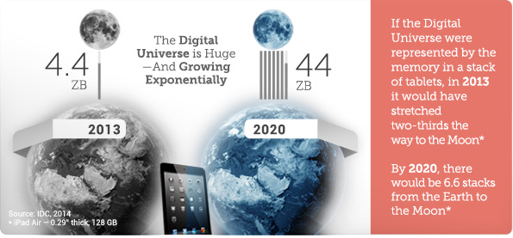
Updated for 2013

Slide 14
What is going on?
the internet?

Slide 15

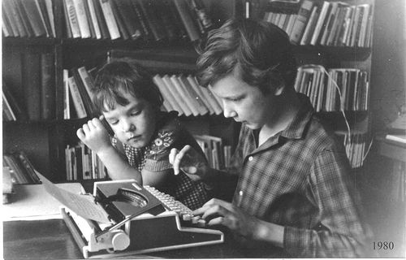
What is going on?
http://flickr.com/photos/mricon/1836673/

Slide 16
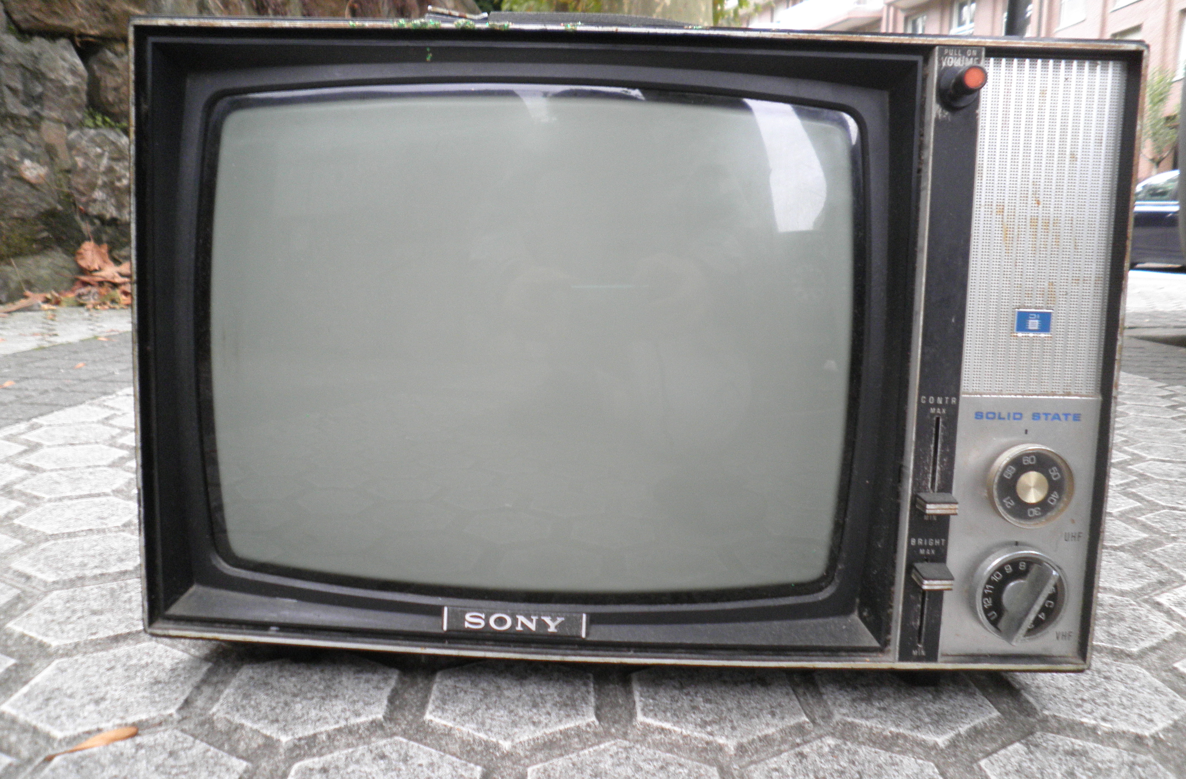

What is going on?
http://upload.wikimedia.org/wikipedia/commons/c/c1/Sony_tv_set_0001.JPG

Slide 17

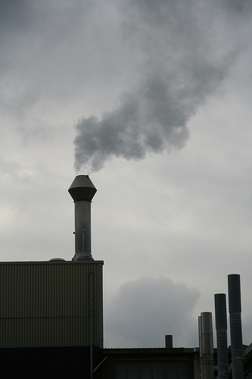

Industrial Revolution of Data!
Software Logs
RFID
GPS
IoT
Quantified self
Microphones
Cameras
...
http://www.flickr.com/photos/revsorg/1168346563/

Slide 18
This makes me feel…

Slide 19
This makes me feel…
information is knowledge
albert einstein
knowledge is power
sir francis bacon
with great power comes great responsibility
uncle ben

Slide 20
This makes me feel…
“With a collaborative spirit, with a collaborative platform where people can upload data, explore data, compare solutions, discuss the results, build consensus, we can ... engage passionate people, local communities, media and this will raise – incredibly – the amount of people who can understand what is going on. And this would have fantastic outcomes: the engagement of people, especially new generations; it would increase knowledge, unlock statistics, improve transparency and accountability of public policies, change culture, increase numeracy, and in the end, improve democracy and welfare.”
Enrico Giovannini, Chief Statistician, OECD. June, 2007

Slide 21

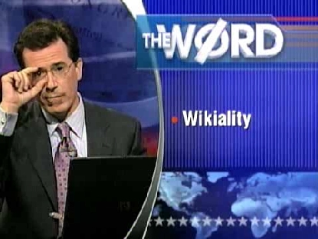
This makes me feel…
Colbert’s Wikiality
together “we can all create a reality that we all can agree on; the reality that we just agreed on.”
“Definitions will welcome us as liberators”
COMEDY CENTRAL VIDEO ARCHIVE VIA WIKIPEDIA

Slide 22
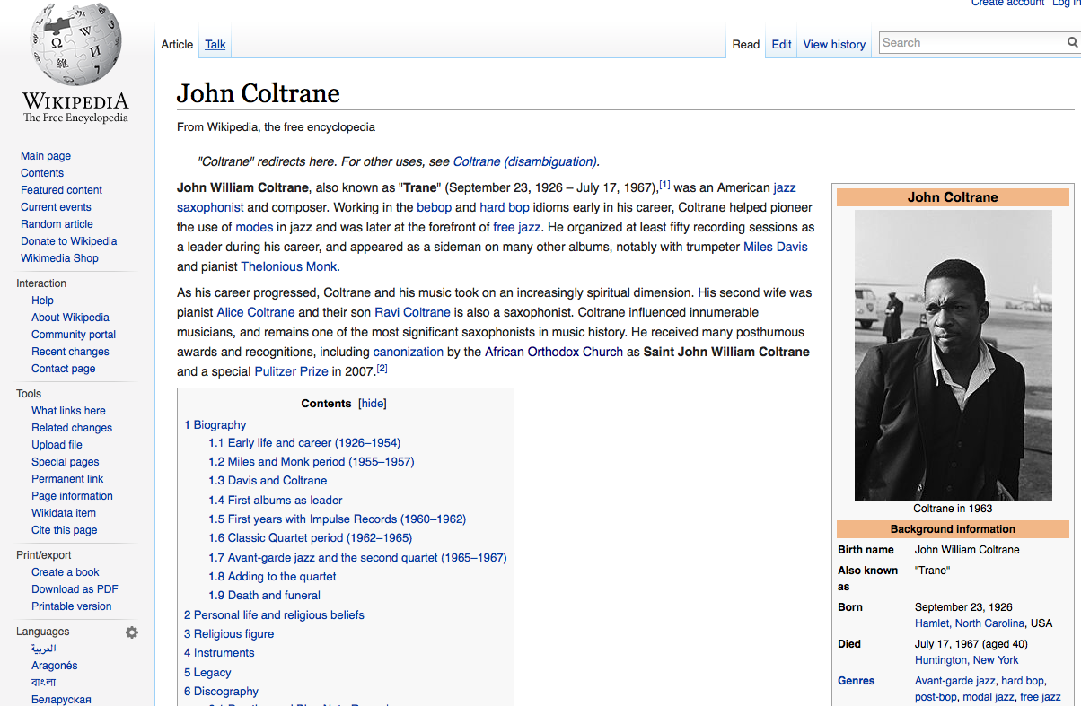
This makes me feel…

Slide 23
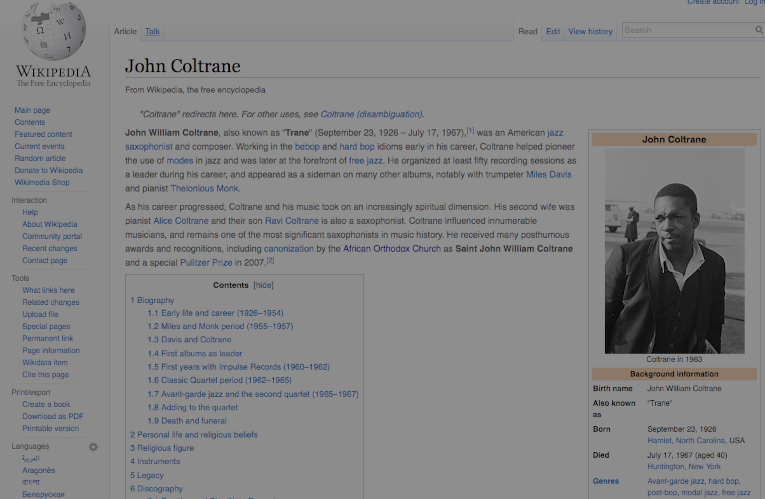
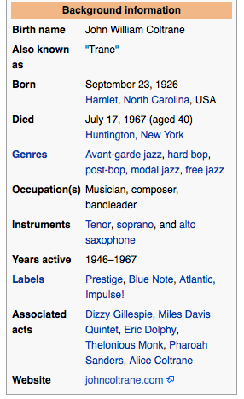
This makes me feel…

Slide 24
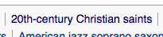
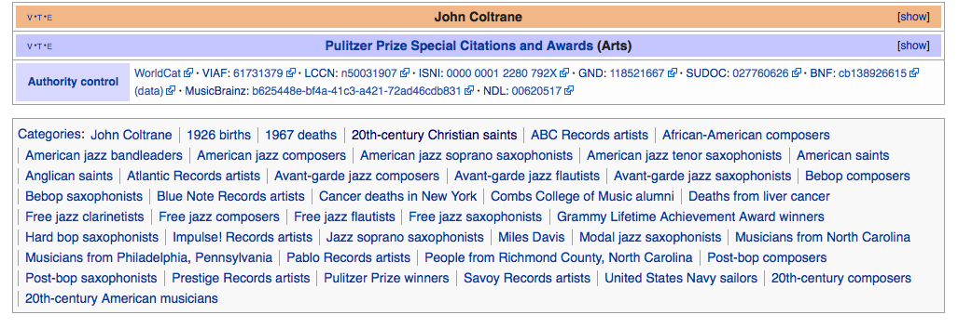
This makes me feel…

Slide 25
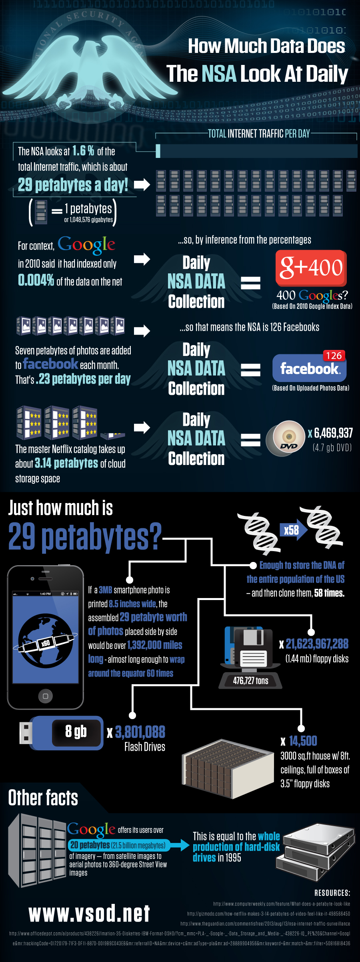
This makes me feel…

Slide 26

This makes me feel…
76% of children born in sub-Saharan Africa are unregistered - UNICEF, 2008.

Slide 27
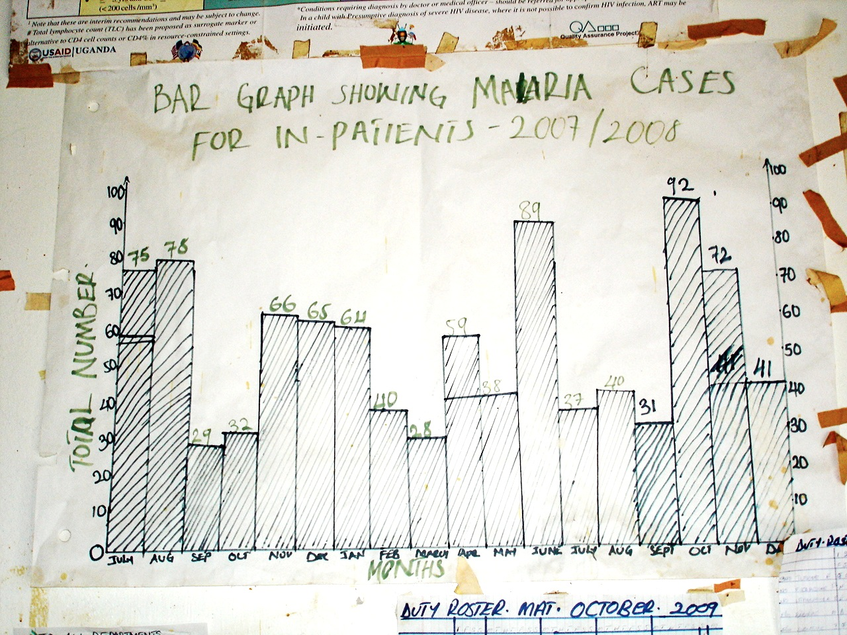
This makes me feel…

Slide 28
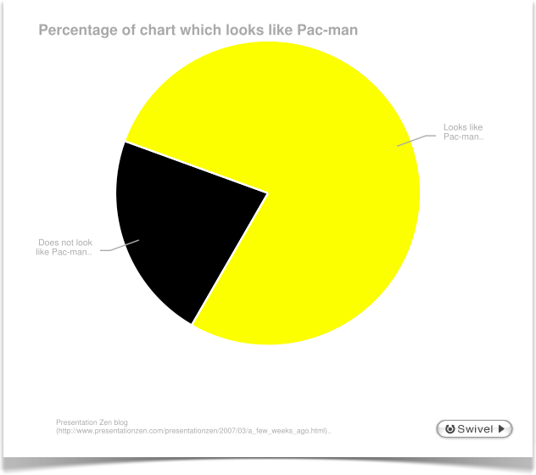
This makes me feel…

Slide 29
So…Why?
Data will be at the center of the major issues and events of our lives.

Slide 30
Queries for Today
Why?
What?
Who?
How?
For instance?

Slide 31
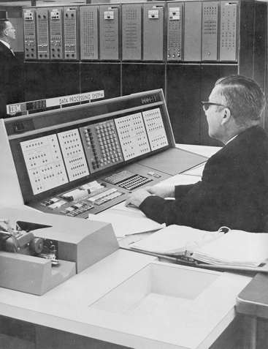
What: Spot the Database

Slide 32
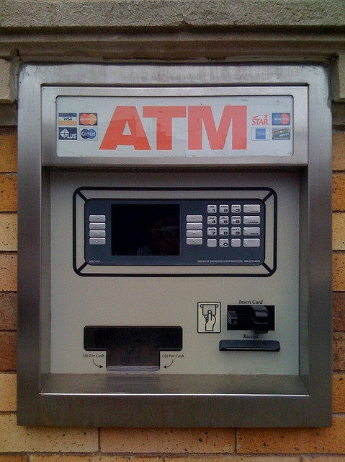
What: Spot the Database

Slide 33
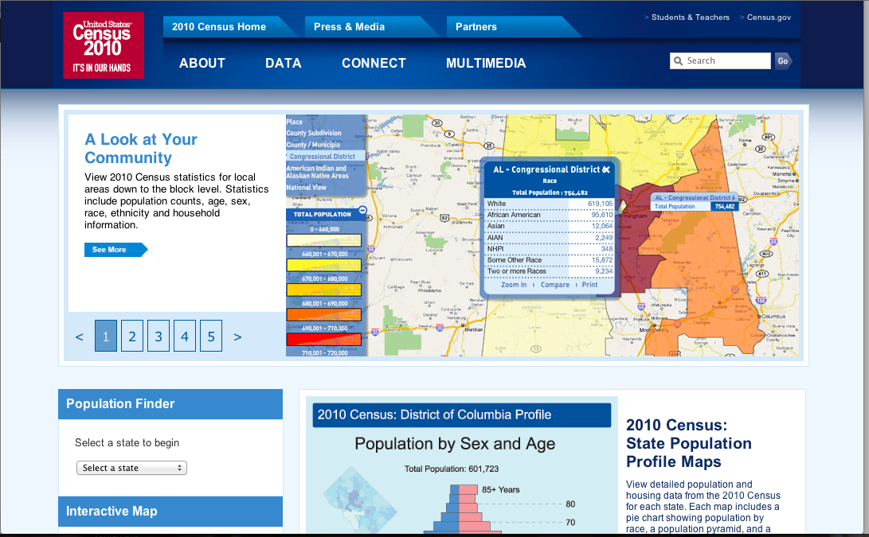
What: Spot the Database

Slide 34
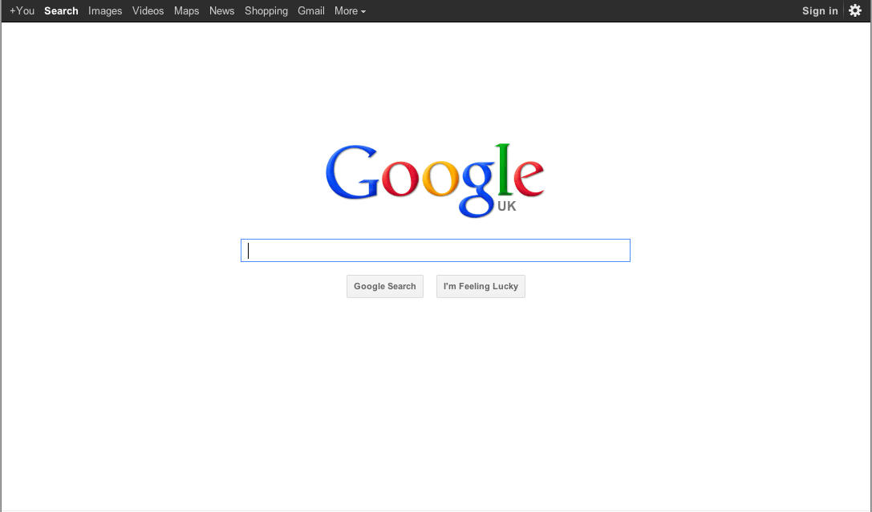
What: Spot the Database

Slide 35
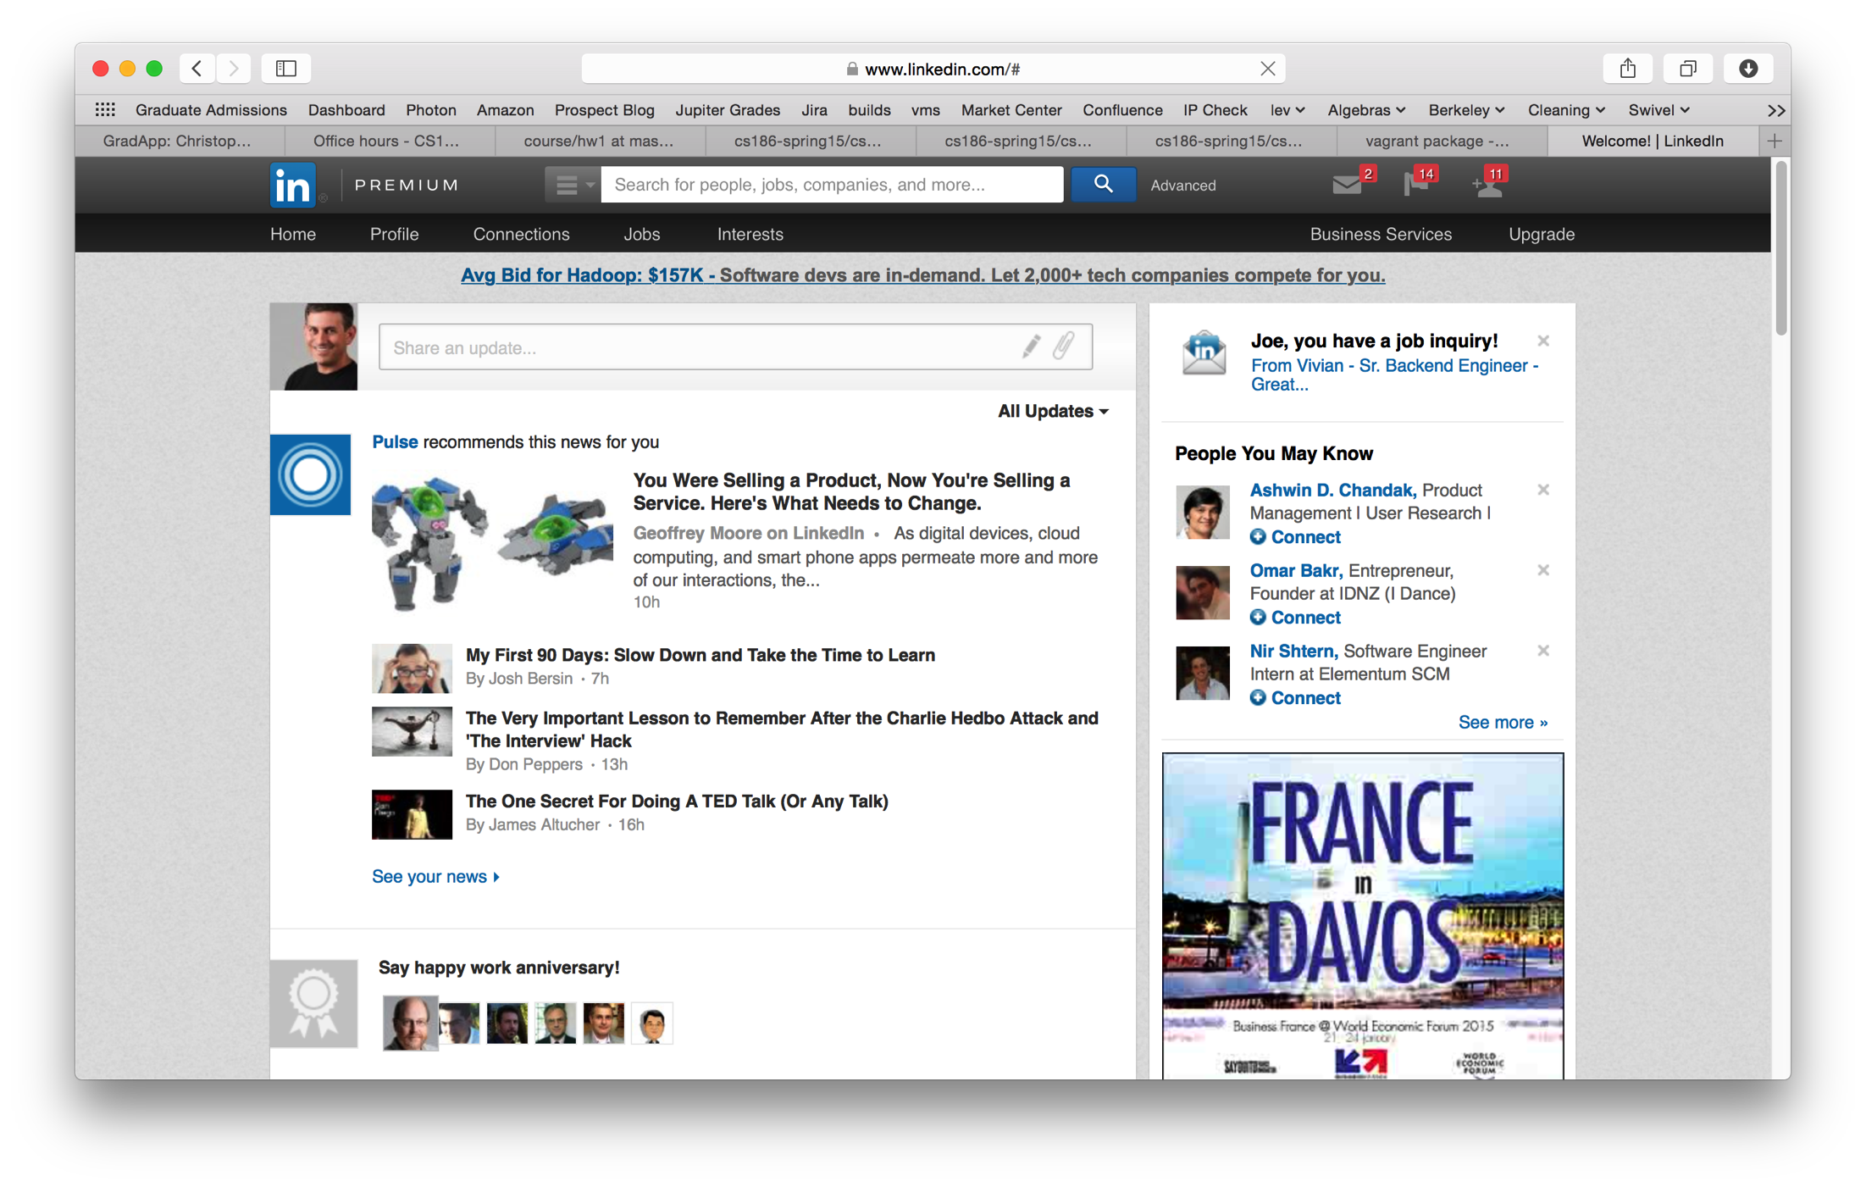
What: Spot the Database

Slide 36
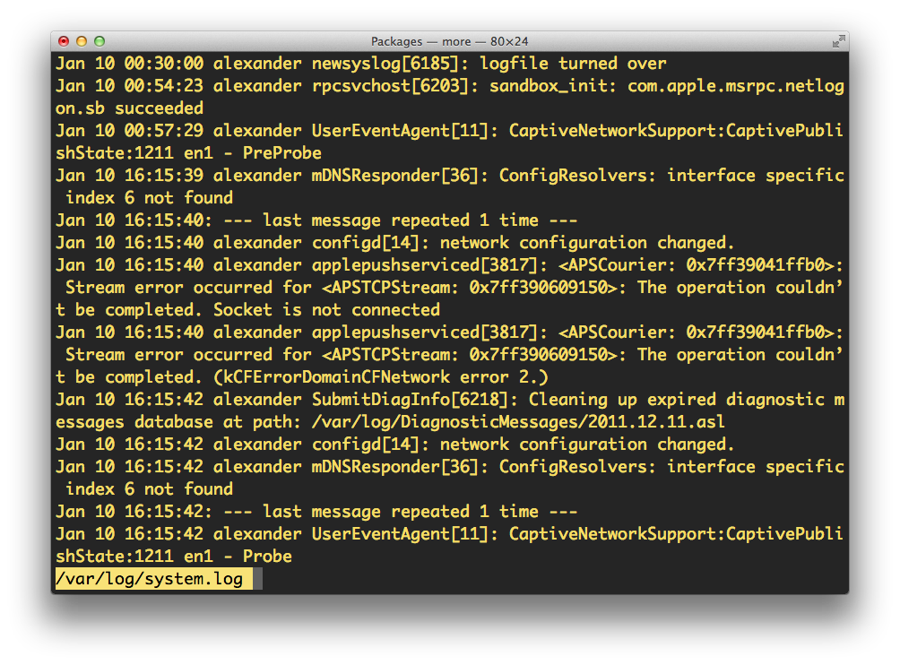
What: Spot the Database

Slide 37
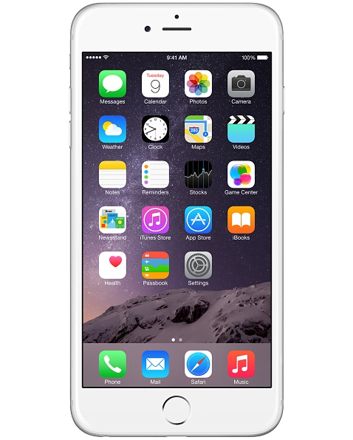
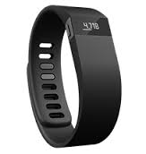
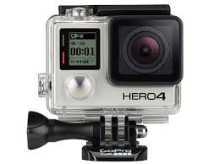
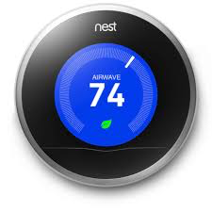
What: Spot the Database

Slide 38
What is a Database?
Let’s not split hairs.
A database is a large collection of structured data

Slide 39
What is a DBMS?
A Database Management System (DBMS) is software that stores, manages and/or facilitates access to databases.
Traditionally, term was used narrowly
Relational databases with transactions
Now market and terms in rapid transition
The tech remains (roughly) the same
Various pressures to remix this tech in new ways.
HW
Volume
Widening variety of usage
Good time to focus on fundamentals!

Slide 40
What: Is an OS a DBMS?
Data can be stored in RAM
every programming language offers this
RAM is fast, and random access
isn’t this heaven?

Slide 41
What: Is an OS a DBMS?
Data can be stored in RAM
every programming language offers this
RAM is fast, and random access
isn’t this heaven?
Every OS includes a File System
manages files on a persistent disk
allows open, read, seek, close on a file
allows protections to be set on a file
drawbacks relative to RAM?

Slide 42
What: File System vs DBMS
Thought Experiment 1:
You and your project partner edit the same file.
You both save it at the same time.
Whose changes survive?
yours
partner’s
both
neither
???

Slide 43
What: File System vs DBMS
Thought Experiment 1:
You and your project partner edit the same file.
You both save it at the same time.
Whose changes survive?
Thought Experiment 2:
You’re updating a file.
The power goes out.
Which changes survive?
yours
partner’s
both
neither
???
all
none
all since last save
???

Slide 44
What: File System vs DBMS
Thought Experiment 1:
You and your project partner edit the same file.
You both save it at the same time.
Whose changes survive?
Thought Experiment 2:
You’re updating a file.
The power goes out.
Which changes survive?
Q: How do you code against an API that guarantees you “???” ?
A: Very carefully.
yours
partner’s
both
neither
???
all
none
all since last save
???

Slide 45
What: Database Systems
What more could we want than a file system?
Clear API contracts regarding data
concurrency control, replication, recovery
Simple, efficient, well-defined ad hoc¹ queries
Efficient, scalable bulk processing
Benefits of good data modeling
S.M.O.P.²? Not really…
¹ad hoc: formed or used for specific or immediate problems or needs
²SMOP: Small Matter Of Programming

Slide 46
What: Current Market
Relational DBMSs still anchor the software industry
Elephants: Oracle, Microsoft, IBM, Teradata, HP, EMC, …
Open source: MySQL, PostgreSQL
Emerging Variants: In-Memory, Column-oriented
Open Source “NoSQL” is growing
Analytics: Hadoop MapReduce, Spark
Key-value stores: Cassandra, Mongo, Couch, …
Search SW is an important special case
Google & Bing, Solr, Lucene
Cloud services are expanding quickly
Amazon Redshift/ElasticSearch/EMR, MS Azure, Heroku, …

Slide 47
What will we learn?
Design patterns for computing with data
When, why and how to structure your data
Basics of how Oracle and Google work
SQL ... and noSQL
Managing concurrency
Fault tolerance and Recovery
Scaling out: parallelism and replication
Audacity and Reverence.

Slide 48
What: Summing up
Data is at the center of many things.

Slide 49
What: Summing up
Data is at the center of many things.
everything

Slide 50
What: Summing up
Data is at the center of many things.
For instance: computer science.
everything

Slide 51
What: Summing up
You might think: in CS186 we learn to apply computer science to Big Data.
This class should apply very broadly.
No. The techniques we’ll learn in CS186 are the key to scalable computer science.

Slide 52
Be the tip of the spear
These professions are just emerging:
Cloud programmer
Data scientist
Data engineer
Machine Learning architect
In 5 years, this will be a large fraction of the computing workforce.
Now is the time!

Slide 53
Who?
Instructor
Prof. Joe Hellerstein
TAs
Derek Leung
Varun Naik
Michelle Ng
Jay Patel
Vikram Sreekanti
Anthony Sutardja

Slide 54
How? Workload
Homework with real world focus:
Wrangle messy data to extract structure
Code up scalable algorithms
Modify internals of a big data engine
Develop custom data visualization
Short weekly quizzes
Exams – 2 Midterms & 1 Final

Slide 55
How? Administrivia
http://cs186berkeley.net or https://sites.google.com/site/cs186spring2015/
Ofc Hrs & sections on the web

Slide 56
How? Administrivia, cont.
Textbook
Database Management Systems, 3rd Edition
Ramakrishnan and Gehrke
Suggested
I wouldn’t buy any more textbooks
Website has links to programming resources
Grading, hand-in policies, etc. are on Web Page
Cheating policy: zero tolerance
We have the technology…

Slide 57
How? Administrivia, cont.
All class communication via Piazza
piazza.com/berkeley/spring2015/cs186
announcements and discussion
read it regularly
post all questions/comments there
direct email is not a good idea
Solo and Team Homework Projects
Teams of 2
Think about this now! Find a partner ASAP.

Slide 58
How? Homework Now!
Two homeworks being issued TODAY!
HW0: Due this Thursday
HW1: Due next Tuesday
Details in the HW github repos, accessible from the class website.

Slide 59
Queries for Today
Why?
What?
Who?
How?
For instance?

Slide 60
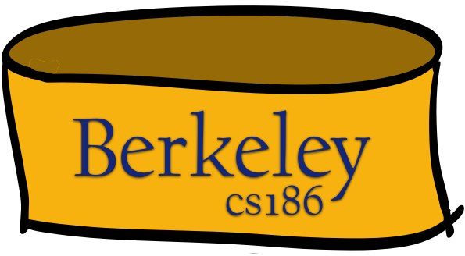
Dealing with Big Data
The Von Neumann machine
1. Read something
2. Do something
3. Write something
4. GOTO 1
CPU

Slide 61
Dealing with Big Data
“Out-of-Core” algorithms.
1. Read something
2. Do something
3. Write something
4. GOTO 1
CPU

Slide 62
Dealing with Big Data
Scaling up
CPU
CPU
CPU
CPU
CPU
CPU
CPU
CPU
CPU

Slide 63
Dealing with Big Data
Distributed Computing and Parallelism
CPU
CPU
CPU
CPU
CPU
CPU
CPU
CPU
CPU

Slide 64
Basic Patterns for Big Data
Streaming
Divide-and-Conquer

Slide 65
Simplifying Assumption
Corollary: can reorder handling of items!
The opposite of Von Neumann.
unordered handling of unordered data
Unordered collections of data items.

Slide 66
Disorder is a friend of Scaling
We can order things to our liking
For cache locality, rendezvous, etc.
We can work on things in batches
Pick batch sizes to fit our memory hierarchy
Pick batch contents based on data affinities
OK to postpone data that doesn’t fit nicely in the current batch
We can tolerate non-deterministic orders
E.g. the result of parallel execution
For efficiency

Slide 67
Streaming through RAM
Simple case: “Map”.
Goal: Compute f(x) for each record, write out the result
Challenge: minimize RAM, call read/write rarely
INPUT
OUTPUT
RAM

Slide 68
Streaming through RAM
Simple case: “Map”.
Goal: Compute f(x) for each record, write out the result
Challenge: minimize RAM, call read/write rarely
Approach
Read a sizable chunk from INPUT to an Input Buffer
Write f(x) for each item to an Output Buffer
When Input Buffer is consumed, read another chunk
When Output Buffer fills, write it to OUTPUT
Input
Buffer
Output
Buffer
INPUT
f(x)
OUTPUT
RAM

Slide 69
Streaming through RAM
Simple case: “Map”.
Goal: Compute f(x) for each record, write out the result
Challenge: minimize RAM, call read/write rarely
Approach
Read a chunk from INPUT to an Input Buffer
Write f(x) for each item to an Output Buffer
When Input Buffer is consumed, read another chunk
When Output Buffer fills, write it to OUTPUT
Reads and Writes are not coordinated
E.g., if f() is Compress(), you read many chunks per write.
E.g., if f() is DeCompress(), you write many chunks per read.
Input
Buffer
Output
Buffer
INPUT
f(x)
OUTPUT
RAM

Slide 70
Parallelize Me
Input
Buffer
Output
Buffer
INPUT
f(x)
OUTPUT
RAM

Slide 71
Parallelize Me
Input
Buffer
Output
Buffer
INPUT
f(x)
OUTPUT
RAM
Input
Buffer
Output
Buffer
INPUT
f(x)
OUTPUT
RAM
Input
Buffer
Output
Buffer
INPUT
f(x)
OUTPUT
RAM

Slide 72
UNIX Pipes
STDIN and STDOUT streams
streaming UNIX utilities get/put lines
Connect ‘em up with |
OS will do chunking for you
e.g. “find students who got 100 on one assignment, and got 0 on no assignments”
% sed 1d grades.csv | grep ',100'| grep -v ',0' | cut -f 1 -d ','

Slide 73
Handy streaming UNIX utils
head, tail, nl, tr, tail, tee, od, cut, grep, sed, awk, split, csplit, …

Slide 74
Rendezvous
Streaming: one chunk at a time. Easy.
But some algorithms need certain items to be co-resident in memory
not guaranteed to appear in the same input chunk
Time-space Rendezvous
in the same place (RAM) at the same time
There may be many combos of such items

Slide 75
Divide and Conquer
Out-of-core algorithms orchestrate rendezvous.
Typical RAM Allocation:
Assume B chunks worth of RAM available
Use 1 chunk of RAM to read into
Use 1 chunk of RAM to write into
B-2 chunks of RAM as space for rendezvous
B-2
DISK 2
DISK 1
INPUT
OUTPUT
IN
OUT

Slide 76
Divide and Conquer
Phase 1
“streamwise” divide into N/(B-2) megachunks
conquer each and write to disk
B-2
DISK 2
DISK 1
INPUT
OUTPUT
IN
OUT

Slide 77
Divide and Conquer
Phase 2
a streaming algorithm over conquered megachunks.
the streaming must ensure rendezvous
but among rendezvous groups, order still immaterial!
B-2
DISK 2
DISK 1
INPUT
OUTPUT
IN
IN

Slide 78
Parallelize Me?
Phase 1
B-2
IN
OUT
B-2
IN
OUT
B-2
IN
OUT

Slide 79
Parallelize Me?
Phase 1+: partition data, communicate for rendezvous in space!
B-2
B-2
IN
OUT
IN
OUT
B-2
B-2
IN
OUT
IN
OUT
B-2
B-2
IN
OUT
IN
OUT

Slide 80
Handy UNIX r’vous utils
non-streaming: sort, wc, tsort
“stream rendezvous”: uniq, join, paste
require sorted inputs
for more UNIX goodness:
http://en.wikipedia.org/wiki/List_of_Unix_utilities
sort table on Category, search for “Text Processing”

Slide 81
Summing Up 1
Unordered collection model
Read in chunks to avoid fixed I/O costs
Two main techniques
Streaming
Divide & Conquer for rendezvous
Parallelism falls out fairly naturally

Slide 82
Summing Up 2
Pure streaming is fast and low-memory
one-pass
chunking minimizes I/O fixed costs
Try to avoid ordering requirements

Slide 83
Up Next
Two kernels for rendezvous in detail:
out-of-core sorting
out-of-core hashing
...they differ in the order of divide vs conquer

